Slide 1
Autonomous cars
Who should be held legally accountable in event of an accident?

Slide 2
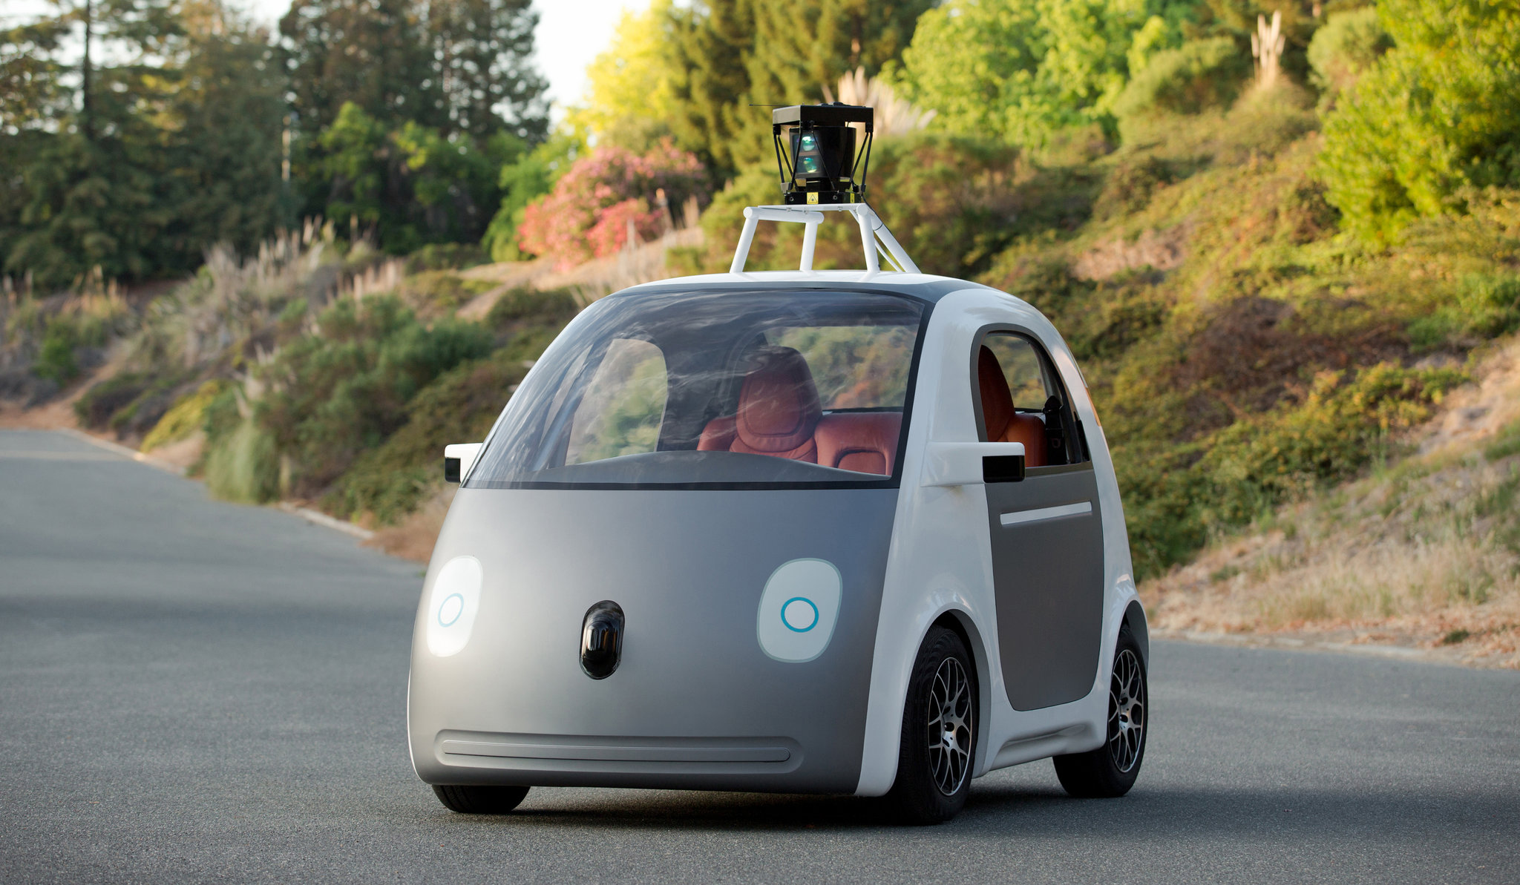
What are autonomous cars?
Vehicle capable of sensing its environment
Operating without human involvement
Human passenger is not required to be present take control of the vehicle at any time

Slide 3
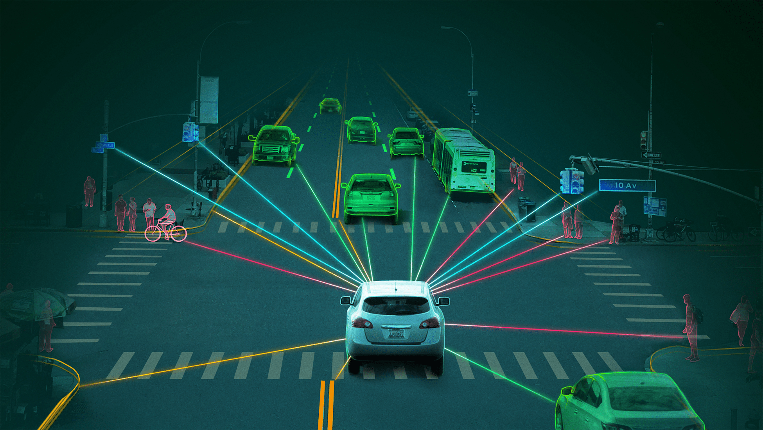
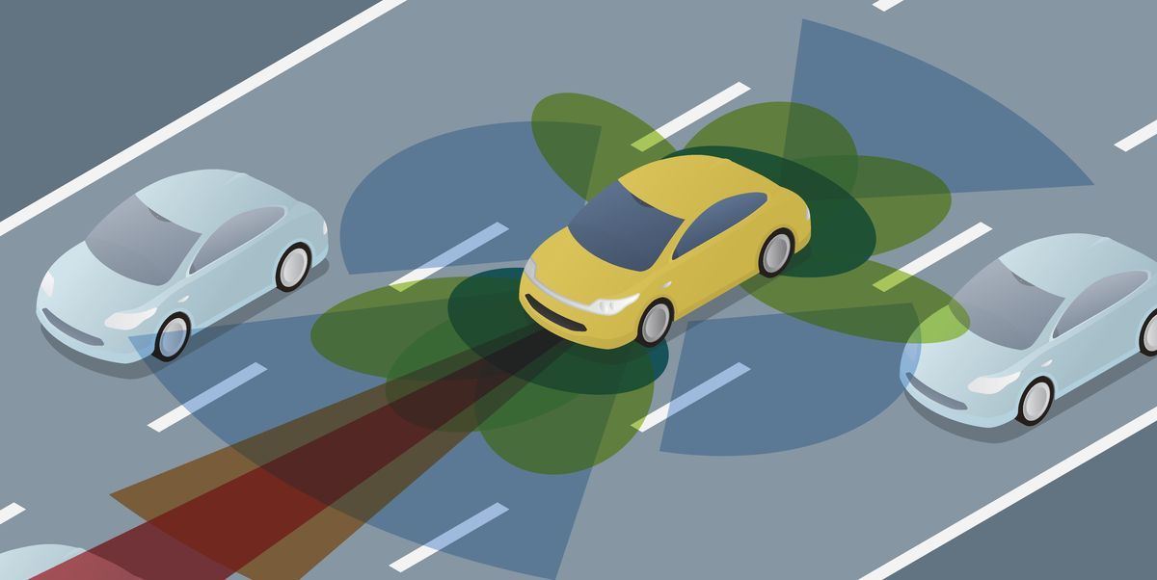
How do autonomous cars work?
Rely on sensors, actuators, complex algorithms, machine learning systems, and powerful processors to execute software
Create and maintain a map of their surroundings based on a variety of sensors situated in different parts of the vehicle
Sophisticated software then processes all this sensory input, plots a path, and sends instructions to the car’s actuators, which control acceleration, braking, and steering. Hard-coded rules, obstacle avoidance algorithms, predictive modeling, and object recognition help the software follow traffic rules and navigate obstacles.

Slide 4
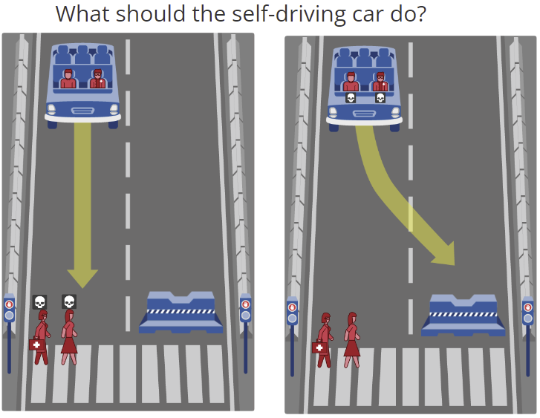
Morality and autonomous cars
Morality needs to be programmed into autonomous cars ahead of time
However a study in 2018 concluded that morals vary country to country, making it impossible to develop a car that universally satisfies the ethical frameworks adopted across the world

Slide 5
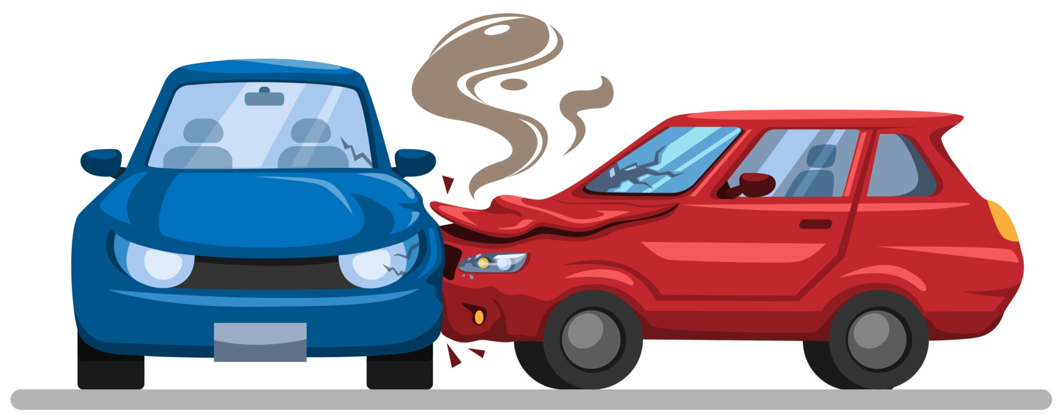
What happens if there is an accident?
Who is responsible?
the owner?
the manufacturer?
the insurance company?
the AI developer?
The UK have proposed that the legal responsibility for accidents caused by self driving vehicles should rest with the company or body that obtained authorisation for the self-driving features used by the vehicle, NOT the person in the driver’s seat
In theory, the following entities could be liable:
Manufacturer of the car
Designer of the software
Fleet owner
Manufacturer of the vehicle’s components

Slide 6

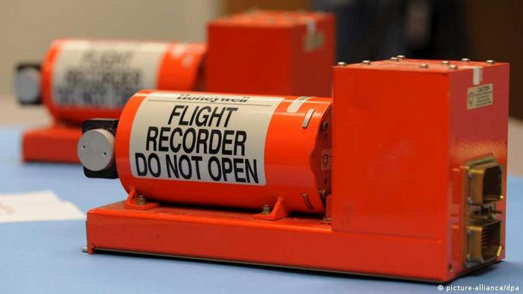
What evidence is required to prove fault?
Data collected by the vehicle sensors would provide evidence for:
Whether the car was being driven by a human or in autonomous-mode
Video footage of the incident
Record of sensor input data and output actions from software
Status of vehicle/sensors
Any aspect relating to the maintenance or autonomous driving of the vehicle (i.e. software) would place liability onto the manufacturer.

